Slide 1

MALLA REDDY COLLEGE OF ENGINEERING & TECHNOLOGY (Autonomous Institution – UGC, Govt. of India) DEPARTMENT OF COMPUTER SCIENCE AND ENGINEERING
Secure Visitor Pass Generator Using Blockchain
Team – C2 P. Yuva Akhil -22N31A05G9 P. Bhargava sai-22N31A05J9 M. Irfan -22N31A05E0
Under the Guidance of
Mr. P. Dastagiri Reddy M.tech,(Ph.D)
Assistant Professor

Slide 2
AGENDA
Abstract
Introduction
Existing system
Proposed system
Software and Hardware Requirements
Literature survey
UML Diagrams
Technologies
Modules Explanation
Output screens
Conclusion
Future scope
References

Slide 3
Abstract
This project proposes a secure digital gate pass system leveraging Optical Character Recognition (OCR) and blockchain technology to modernize visitor management. The application allows users to upload an ID card image, from which visitor details such as name, ID number, and photo are automatically extracted using OCR. These details are verified and recorded as a secure transaction on a decentralized blockchain ledger via a connected digital wallet. The system then generates a tamper-proof gate pass featuring a unique ID, QR code, and verifiable transaction reference. This enhances transparency, reduces the risk of forgery, and streamlines gate access through an efficient and secure verification process. Key modules include image upload, OCR processing, blockchain logging, gate pass generation, and pass management.

Slide 4
Introduction
Secure Visitor Pass System Integrates OCR and blockchain for modern, secure visitor management.
Automated ID Processing Extracts visitor details like name, ID number, and photo using OCR from uploaded ID cards.
Tamper-Proof Data Recording Records visitor information on a decentralized blockchain ledger for immutability and transparency.
QR-Based Gate Pass Generates a digital pass with unique ID, QR code, and blockchain transaction reference.
Real-Time Admin Control Admin dashboard for reviewing, approving, and managing digital passes instantly.
Improved Security & Verification Prevents forgery and unauthorized access with digital wallet verification and secure pass generation.

Slide 5
Existing system
Manual Visitor Entry Visitors are registered using handwritten logbooks or simple spreadsheets. Prone to data entry errors, delays, and difficult record retrieval.
No Digital Verification Security personnel rely on visual inspection of physical IDs. No real-time cross-verification or authenticity check.
Easy to Forge or Misuse Passes Paper passes can be easily duplicated, tampered with, or reused. Lack of unique identifiers or secure reference codes.
No Blockchain or Immutable Logs Visitor data is stored in unprotected formats. No tamper-proof audit trail or reliable digital backup.
Limited Admin Control Gate pass review, revocation, or monitoring must be done manually. No centralized interface for tracking or verification.

Slide 6
Proposed system
Smart Visitor Entry Visitor uploads official ID card image via web interface. OCR technology extracts name, ID number, and photo instantly.
Secure Identity Verification Visitor connects to Albedo Wallet for secure digital signing. Authenticates data and initiates blockchain transaction.
Blockchain-Enabled Pass Generation Visitor details are recorded on the Stellar blockchain. Tamper-proof and verifiable using transaction hash.
QR-Based Gate Pass A digital pass is generated with unique ID and QR code. Security staff can instantly verify using a scanner.
Improved Efficiency and Security Fully digitized and decentralized solution with cryptographic protection. Reduces fraud risk, improves transparency, and speeds up entry process.

Slide 7
Software Requirements
Backend Framework: Node.js with Express.js – JavaScript backend for building APIs and blockchain integration
OCR Engine: Tesseract.js – For extracting visitor details from uploaded ID images
Blockchain & Wallet Integration: Stellar Blockchain + Albedo Wallet – For secure, verifiable, and decentralized visitor logging
Decentralized Storage: Pinata with IPFS – For securely storing ID images and accessing them via IPFS hashes
Frontend Framework: React.js and TypeScript – For building responsive and interactive UI
Development Tools: Node.js 18+, npm IDE/Text Editor: Visual Studio Code
Version Control: GitHub

Slide 8

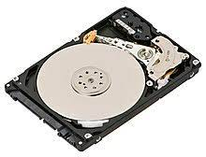

Hardware Requirements
Development Machine:
Processor: Intel i5 or higher (or equivalent AMD).
RAM: Minimum 8 GB (16 GB recommended for model training).
Storage: At least 25 GB (SSD preferred for faster data handling).
Additional Hardware:
Camera(Webcam or smartphone camera for capturing ID images during field use)

Slide 9
Literature Survey
S.no. | Author(s) & Journal Details
1 | S. K. Sharma, A. Roy | Blockchain in Access Control Systems | Uses decentralized ledgers for tamper-proof, immutable visitor records.
2 | M. N. Patil, V. J. Mahajan | Digital Visitor Logbooks via Web Applications | Replaces manual logbooks with real-time, error-free digital entries.
3 | P. Dasgupta, V. Iyer | Modular Architecture for Visitor Pass Systems | Suggests scalable, plug-and-play design allowing easy integration of biometrics, mobile apps, and multilingual support..
Title of the paper
Title of the paper
Outcome
Outcome

Slide 10
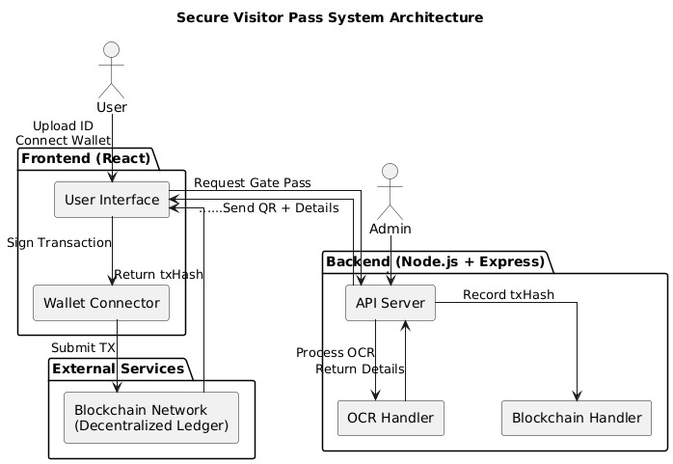
Architecture

Slide 11
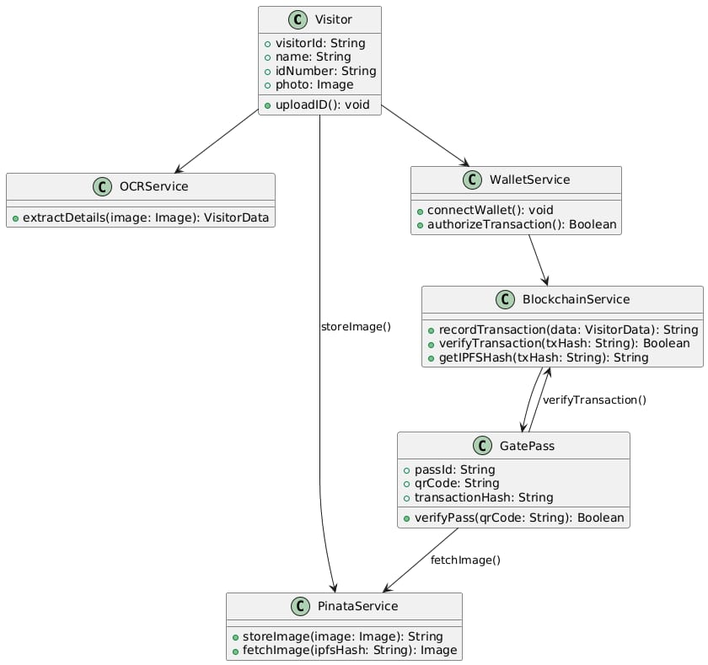
UML Diagrams 1.Class Diagram

Slide 12
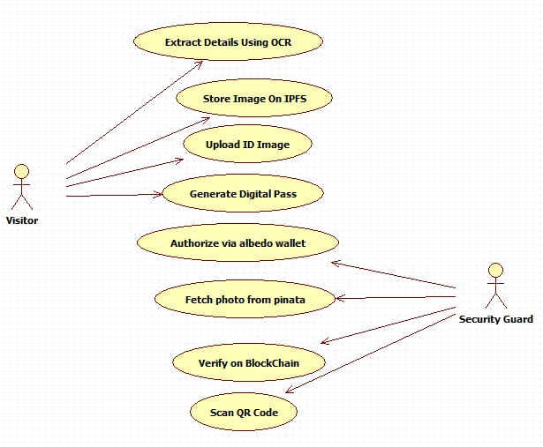
2.Use Case Diagram

Slide 13
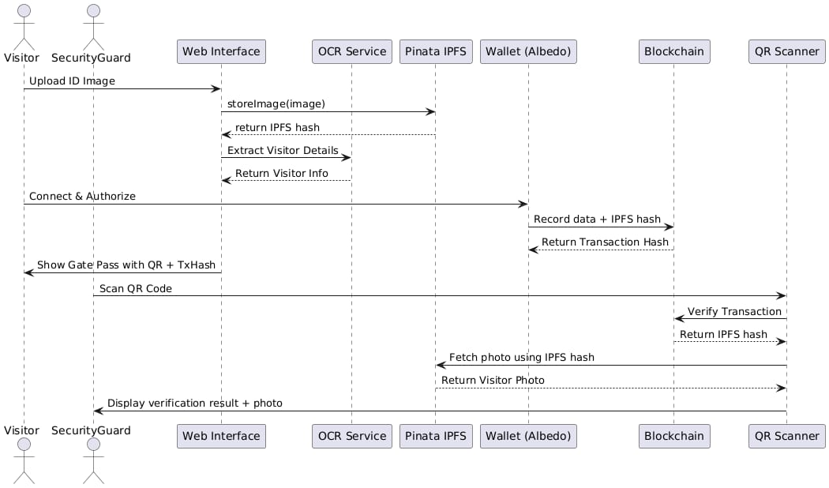
3.Sequence Diagram

Slide 14
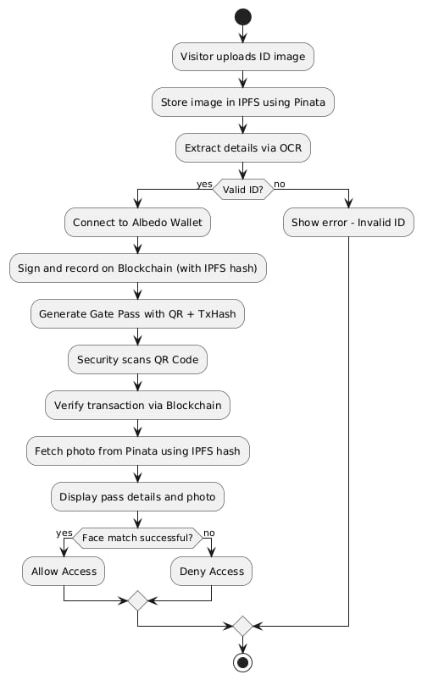
4.Activity Diagram

Slide 15
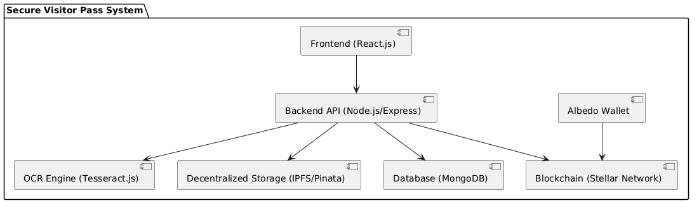
5.Component Diagram

Slide 16
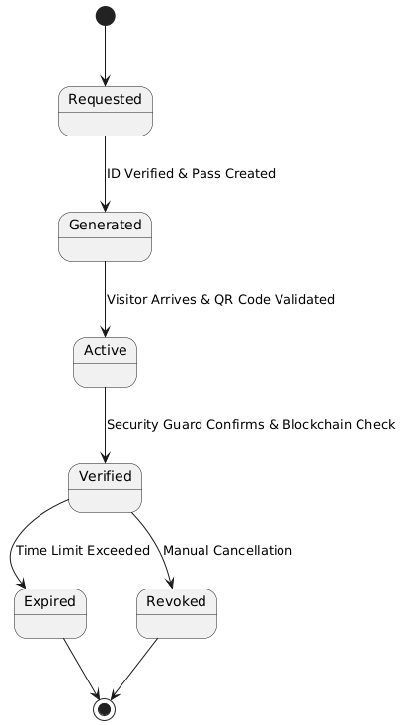
6.State Chart Diagram

Slide 17
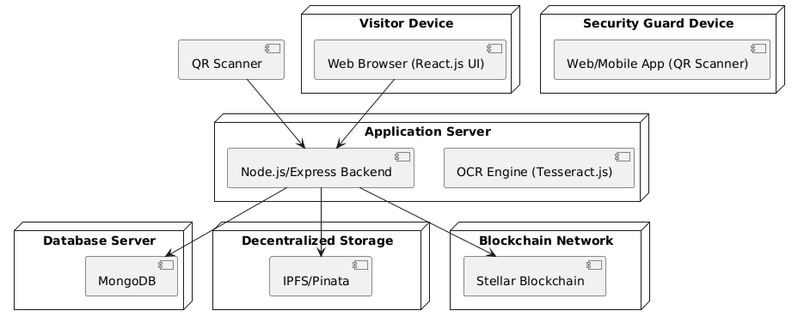
7.Deployment Diagram

Slide 18
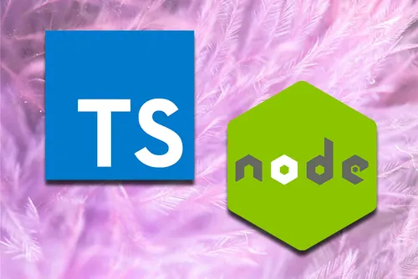

Technologies
React.js – Frontend framework for the user interface.
TypeScript – Strongly typed language for frontend development.
Node.js + Express.js – Backend server for API handling.
Albedo Wallet Integration – For secure blockchain transactions.
OCR (Optical Character Recognition) – For extracting visitor details from ID cards.
Blockchain – For secure, tamper-proof gate pass records.
QR Code Generation – For unique, scannable gate passes.

Slide 19
Modules Description
Image Upload – Users upload their Aadhaar/ID card image through the application interface for processing.
OCR Processing – The system extracts visitor details like name, ID number, and photo using Optical Character Recognition.
Blockchain Logging – Visitor details are securely recorded on a decentralized ledger for tamper-proof tracking.
Gate Pass Generation – A digital pass is created with a unique ID and QR code linked to the blockchain record.
Pass Management – Admin reviews, approves, or rejects passes, ensuring controlled and verifiable access

Slide 20
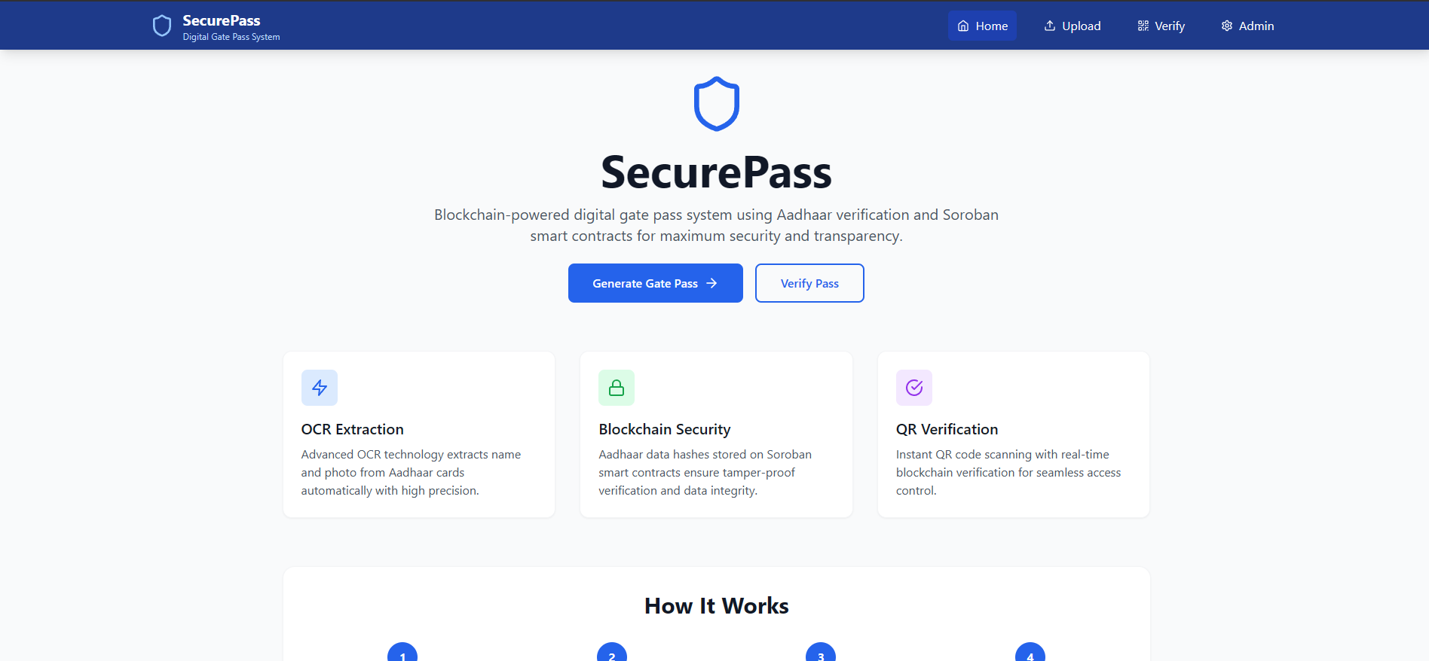
Output Screens

Slide 21
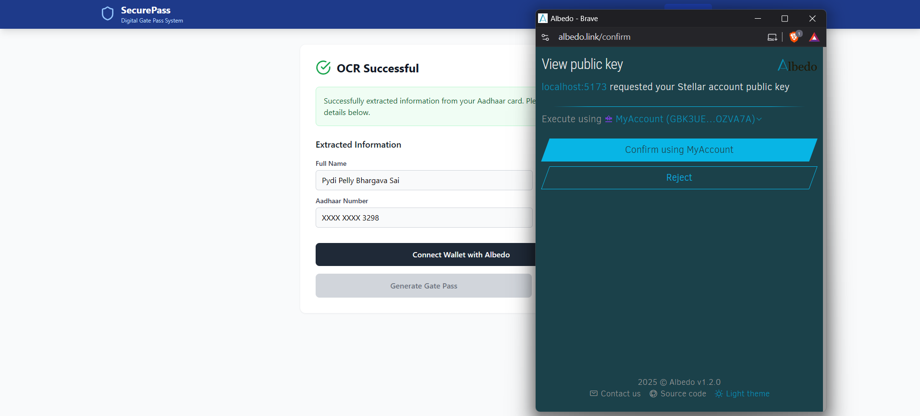
Output Screens

Slide 22
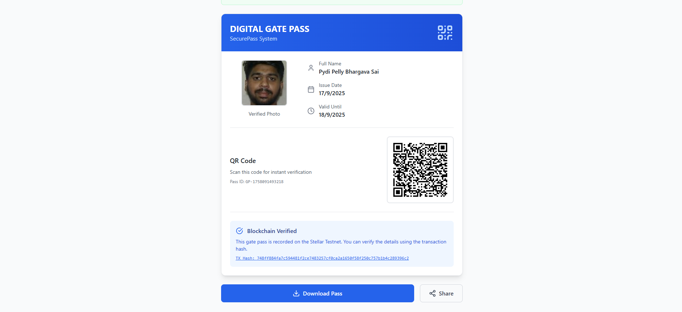
Output Screens

Slide 23
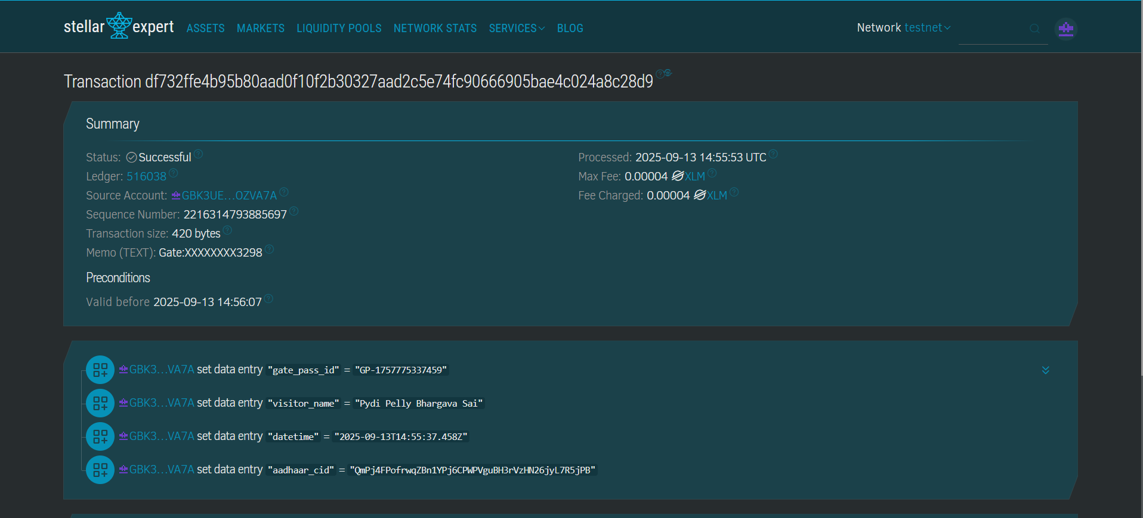
Output Screens

Slide 24
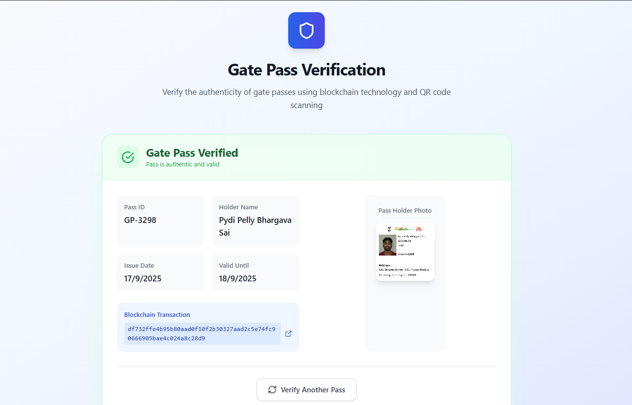
Output Screens

Slide 25
Conclusion
The proposed system successfully integrates OCR and blockchain to create a tamper-proof visitor pass system.
It overcomes the limitations of manual systems such as errors, forgery, and lack of real-time verification.
OCR ensures automated and accurate extraction of visitor details, reducing administrative burden.
Blockchain logging provides immutability, transparency, and decentralized verification of visitor records.
The QR-based gate pass simplifies validation for security personnel, making the entry process faster and more reliable.
The system enhances efficiency, security, and accountability, making it suitable for institutions, corporate offices, and government organizations.

Slide 26
Future Scope
Multi-Blockchain Support – Extend beyond Stellar to other blockchains (e.g., Ethereum, Hyperledger) for interoperability.
Mobile App Development – Build a cross-platform mobile app (Android/iOS) for real-time pass generation and verification.
AI-Powered OCR – Use deep learning models to improve OCR accuracy for different ID formats and languages.
Scalability for Enterprises – Deploy on cloud infrastructure to support large organizations, universities, and smart cities.
Visitor Analytics Dashboard – Provide advanced analytics and reporting for monitoring visitor trends and enhancing security.

Slide 27
References
Goodfellow, I., Bengio, Y., & Courville, A. (2016). Deep Learning. MIT Press.
Smith, R. (2007). "An Overview of the Tesseract OCR Engine." Proceedings of ICDAR 2007, IEEE.
Narayanan, A., Bonneau, J., Felten, E., Miller, A., & Goldfeder, S. (2016). Bitcoin and Cryptocurrency Technologies. Princeton University Press.
Stellar Development Foundation. (2023). Stellar Blockchain Documentation. [Online]. Available: https://developers.stellar.org
Albedo Wallet Docs. (2023). Albedo Wallet Integration Guide. [Online]. Available: https://albedo.link
Pinata. (2023). IPFS & Decentralized Storage Solutions. [Online]. Available: https://pinata.cloud

Slide 28
Thank You

